Slide 1

PRESENTED BY
MADHAV

Slide 3
CICD :
CONTINUOUS INTEGRATION AND CONTINUOUS DEPLOYMENT

Slide 4
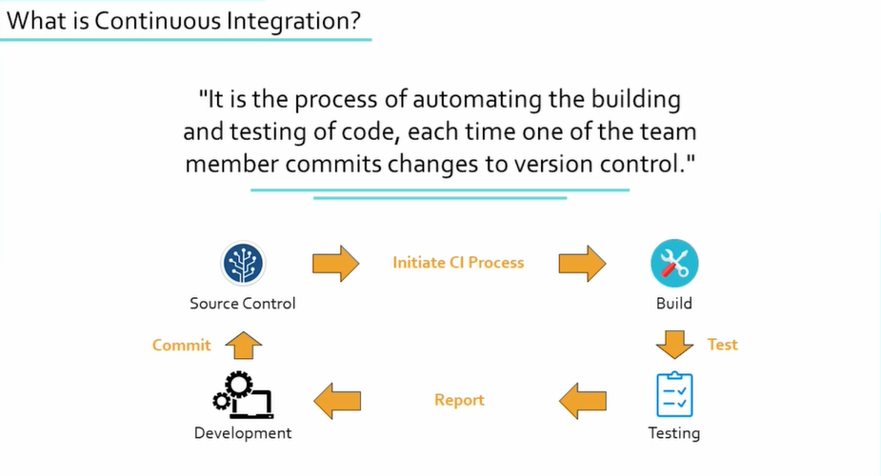

Slide 5
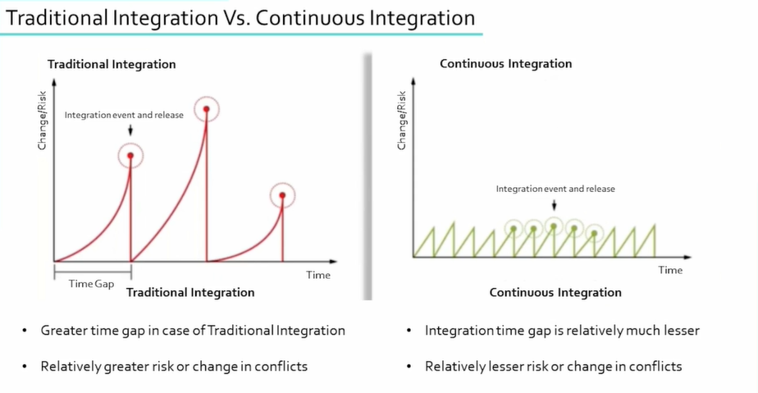

Slide 6
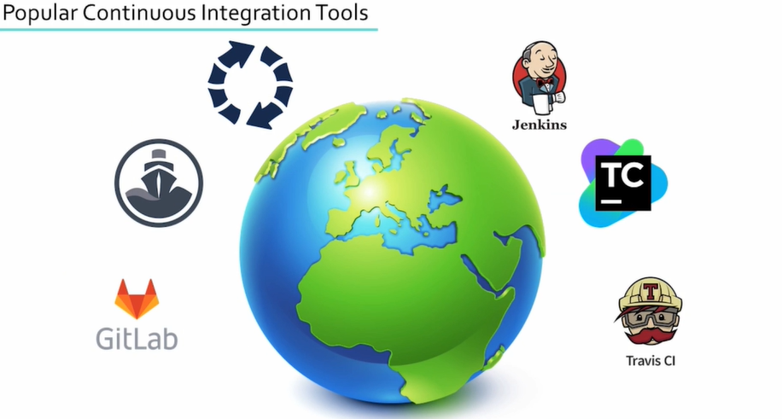

Slide 7

INTRODUCTION TO JENKINS

Slide 8
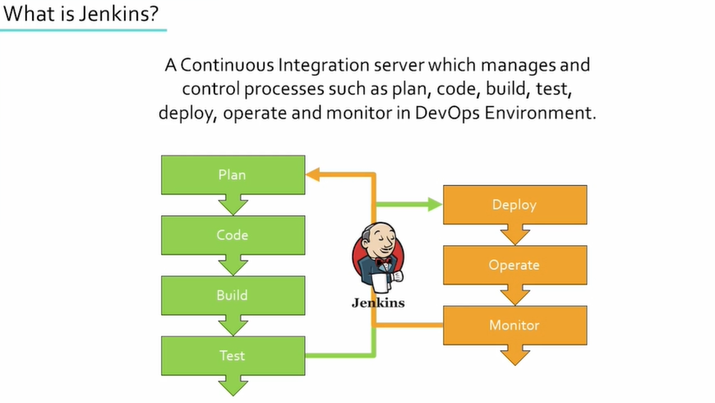

Slide 9
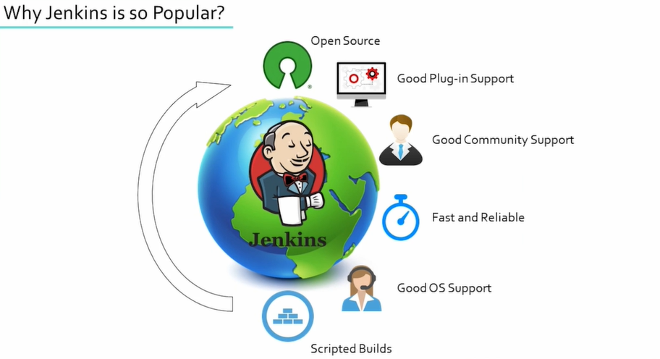

Slide 10
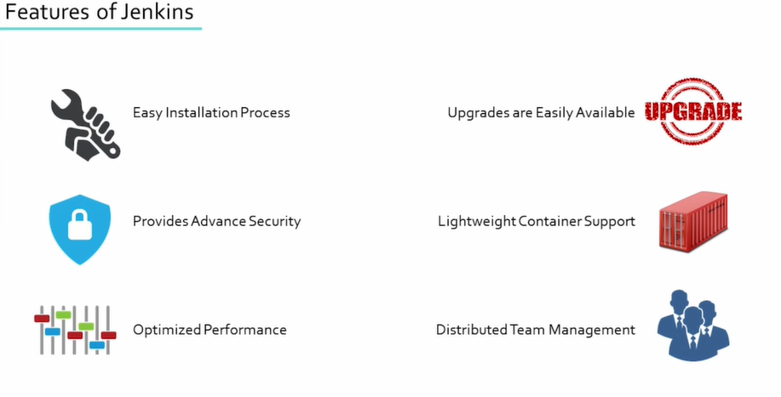

Slide 11
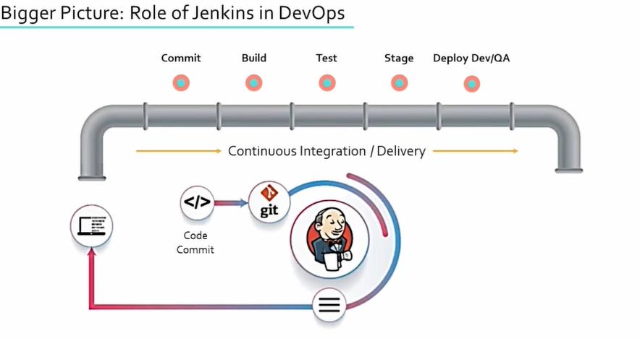

Slide 12
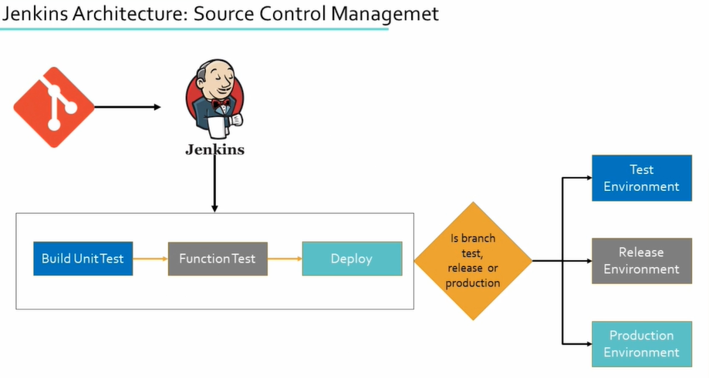

Slide 13
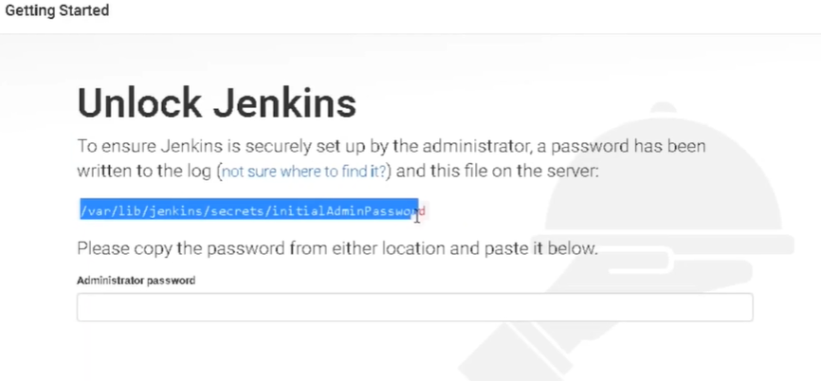

Slide 14
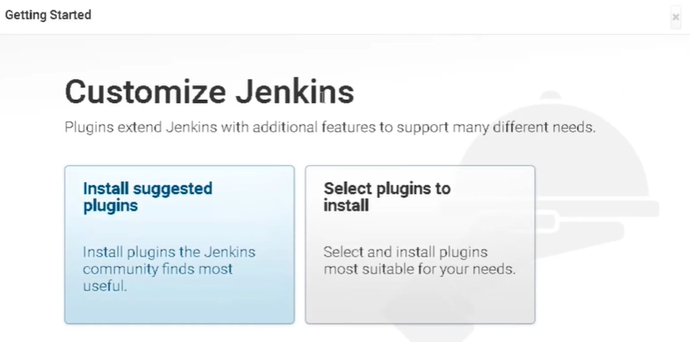

Slide 15

